Slide 1

Computer Network Security
Presented by
Tushar Kumar

Slide 2
Computer Network Security
Computer network security consists of measures taken by business or some organizations to monitor and prevent unauthorized access from the outside attackers.
Different approaches to computer network security management have different requirements depending on the size of the computer network.
For example, a home office requires basic network security while large businesses require high maintenance to prevent the network from malicious attacks.

Slide 3
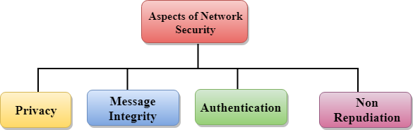

Slide 4
Aspects of Network Security:
Privacy: Privacy means both the sender and the receiver expects confidentiality. The transmitted message should be sent only to the intended receiver while the message should be opaque for other users. Only the sender and receiver should be able to understand the transmitted message as eavesdroppers can intercept the message.
Message Integrity: Data integrity means that the data must arrive at the receiver exactly as it was sent. There must be no changes in the data content during transmission, either maliciously or accident, in a transit.
End-point authentication: Authentication means that the receiver is sure of the sender?s identity, i.e., no imposter has sent the message.
Non-Repudiation: Non-Repudiation means that the receiver must be able to prove that the received message has come from a specific sender. The sender must not deny sending a message that he or she send.

Slide 5
Encryption/Decryption
Encryption: Encryption means that the sender converts the original information into another form and sends the unintelligible message over the network.
Decryption: Decryption reverses the Encryption process in order to transform the message back to the original form.
The data which is to be encrypted at the sender site is known as plaintext, and the encrypted data is known as ciphertext. The data is decrypted at the receiver site.
There are two types of Encryption/Decryption techniques:
Privacy with secret key Encryption/Decryption
Privacy with public key Encryption/Decryption

Slide 6
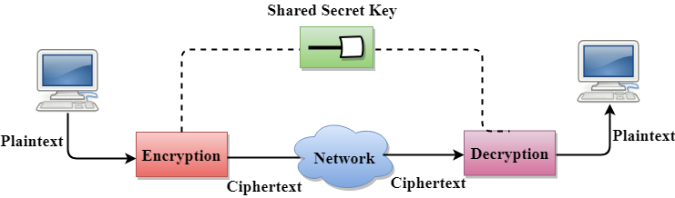
Secret Key Encryption/Decryption technique
Reciver
Sender

Slide 7
Secret Key Encryption/Decryption technique
In Secret Key Encryption/Decryption technique, the same key is used by both the parties, i.e., the sender and receiver.
The sender uses the secret key and encryption algorithm to encrypt the data; the receiver uses this key and decryption algorithm to decrypt the data.
In secret key encryption/decryption algorithm, the secret code is used by the computer to encrypt the information before it is sent over the network to another computer.

Slide 8
Advantage of Secret Key Encryption
Efficient: The secret key algorithms are more efficient as it takes less time to encrypt the message than to encrypt the message by using a public key encryption algorithm.
The reason for this is that the size of the key is small.
Due to this reason, Secret Key Algorithms are mainly used for encryption and decryption.
Disadvantages of Secret Key Encryption
Each pair of users must have a secret key.
If the number of people wants to use this method in the world is N, then there are N(N-1)/2 secret keys.
For example, for one million people, then there are half billion secret keys.

Slide 9
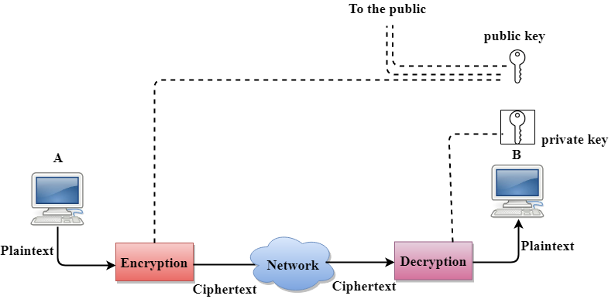
Public Key Encryption/Decryption technique

Slide 10
Public Key Encryption/Decryption technique
There are two keys in public key encryption: a private key and a public key.
The private key is given to the receiver while the public key is provided to the public.
In the above figure, we see that A is sending the message to user B. 'A' uses the public key to encrypt the data while 'B' uses the private key to decrypt the data.
In public key Encryption/Decryption, the public key used by the sender is different from the private key used by the receiver.
The public key is available to the public while the private key is kept by each individual.

Slide 11
Advantages of Public Key Encryption
The main restriction of private key encryption is the sharing of a secret key.
A third party cannot use this key.
In public key encryption, each entity creates a pair of keys, and they keep the private one and distribute the public key.
The number of keys in public key encryption is reduced tremendously.
For example, for one million users to communicate, only two million keys are required, not a half-billion keys as in the case of secret key encryption.
Disadvantages of Public Key Encryption
Speed: One of the major disadvantage of the public-key encryption is that it is slower than secret-key encryption.
Authentication: A public key encryption does not have a built-in authentication. Without authentication, the message can be interpreted or intercepted without the user's knowledge.
Inefficient: The main disadvantage of the public key is its complexity. If we want the method to be effective, large numbers are needed. But in public key encryption, converting the plaintext into ciphertext using long keys takes a lot of time.

Slide 12


